Slide 1
Prepayment Outlook
Q1 2018

Slide 2
PREPAYMENTS WERE ~0.5% CPR FASTER THAN EXPECTATIONS IN Q4 2017
The table shows month-by-month Actual versus Projected prepayments in Q4 2017. Projected prepayments are based on a survey of market participants by Credit Suisse. faster-than-expected prepayments are shaded in red, slower in green, and as-expected in yellow.
Turnover-related prepayments continue to come in somewhat faster than expectations. Aggregate results may have been distorted by January factors, where seasonal influences can be volatile.
The nuance to calculating Aggregate surprises is that market expectations adjust after each factor release so the quarterly surprise number does not necessarily correspond to expectations prior the quarter starting.
Q4 2017 PREPAYMENT REVIEW: EXPECTATIONS VS ACTUAL
Source: Cello, Credit Suisse

Slide 3
MORTGAGE RATES PROBABLY HAVE TO FALL TO 3.25% TO TRIGGER SIGNIFICANT REFIS
The refinanceable fraction of the mortgage universe is an important indicator of prepayment risk.
The two blue lines indicate the % of borrowers for whom a given rate would be the lowest rate (by 50bps or more) they have seen in the life of their mortgage today versus one-year ago.
The graph shows that a decline in mortgage rates would make more borrowers refinanceable than one year ago. Still, mortgage rates would likely have to fall by about 75bps from current levels (30-year mortgage rate of 4.0%) before we saw a noticeable pickup in refinancings.
THE REFINANCEABLE UNIVERSE AS A FUNCTION OF MORTGAGE RATES
Source: Cello

Slide 4
MORTGAGE RATES PROBABLY HAVE TO FALL TO 3.25% TO TRIGGER SIGNIFICANT REFIS
The refinanceable fraction of the mortgage universe is an important indicator of prepayment risk.
The two blue lines indicate the % of borrowers for whom a given rate would be the lowest rate (by 50bps or more) they have seen in the life of their mortgage today versus one-year ago.
The graph shows that a decline in mortgage rates would make more borrowers refinanceable than one year ago. Still, mortgage rates would likely have to fall by about 75bps from current levels (30-year mortgage rate of 4.0%) before we saw a noticeable pickup in refinancings.
THE REFINANCEABLE UNIVERSE AS A FUNCTION OF MORTGAGE RATES
Apr.2017 Mgt Rate: 3.97%
Apr.2018 Mgt Rate: 4.30%
Source: Cello

Slide 5
MORTGAGE CREDIT AVAILABILITY HAS EXPANDED MOST FOR JUMBOS
The MBA’s Mortgage Credit Availability Index (MCAI) tracks the quantity and quality of mortgage credit supplied to borrowers over time and for different segments of the market (Conforming, Government and Jumbo).
The graph shows that credit availability has been relatively stable over the past three years with the exception of Jumbo mortgages which saw an increase of almost 20% in 2017 as lenders expanded their underwriting parameters for this segment of borrowers.
TRENDS IN MORTGAGE CREDIT AVAILABILITY
MCAI
Source: Cello

Slide 6
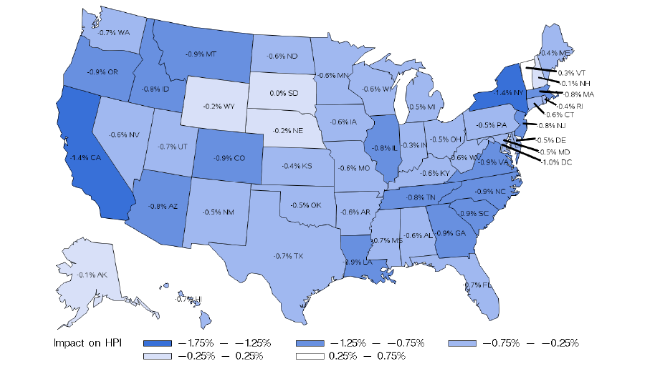
TCJA IMPACT WILL VARY SUBSTANTIALLY BY STATE
Key housing-related TCJA features:
Cap on deductibility of mortgage interest is lowered to $750K from $1mm (existing loans are grandfathered)
Limits SALT deduction to $10K
Increases standard deduction from $13K to $24K for joint filers
Eliminates personal exemption
According to J.P. Morgan, the combination of some loss in the housing subsidy for loans greater than $750K and an increase in after-tax income for certain high income borrowers will shave as much as 1% off the baseline projection for HPA in aggregate.
However, the heatmap depicts the substantial variation by state; areas with high Jumbo loan concentrations will be the most affected.
OVERALL IMPACT OF TAX REFORM ON HOUSE PRICES (%)
TCJA = Negative Impact of 0.9% on HPA relative to baseline
Source: “The impact of tax reform on the housing market”, J.P. Morgan Securitized Products Research, 3rd January, 2018.

Slide 7
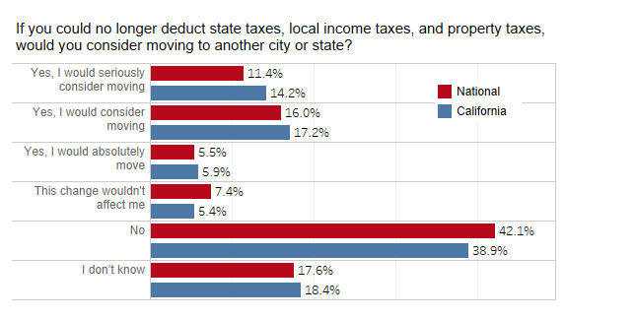
TCJA IMPACT ON CALIFORNIA WILL VARY OVER TIME
While the headline impact of TCJA on house prices suggests a slowdown in prepayments in high-cost states such as California and New Jersey, the short-run impact may be in the opposite direction.
A Redfin survey showed that one-third of homebuyers would consider moving to another city or state if the SALT deduction were to be eliminated. Thus, the initial impact of TCJA may be to increase prepayments in high cost states as some homeowners try to dodge tax increases by moving to another state.
REDFIN SURVEY ON THE IMPACT OF ELIMINATING THE SALT DEDUCTION
Source: Redfin November 2017 survey of homebuyers under contract of planning to buy a home in the coming year.

Slide 8
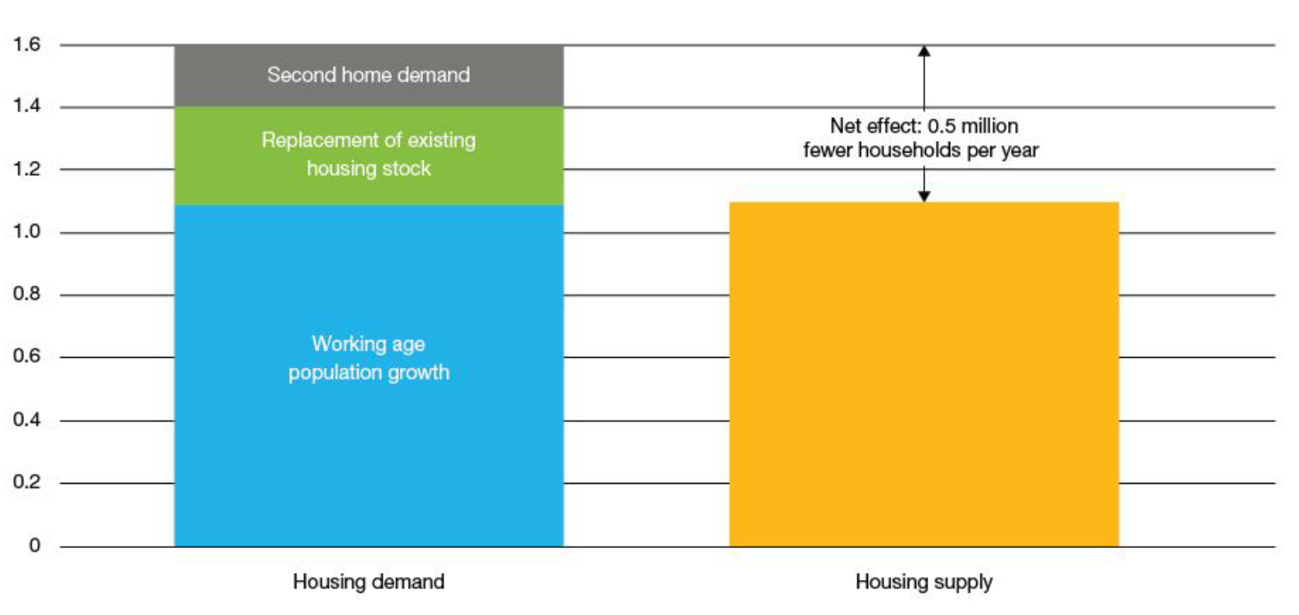
THE BASELINE FORECAST FOR HPA IS STILL ROBUST
House prices appreciated at an annualized rate of 6.4% in 2017 (Q3 data) driven by strong demand, low mortgage rates, and a lack of inventory. Currently, houses are not being built fast enough to close the gap between demand and supply.
House price growth for 2018 is expected to range between 4-5% after incorporating the projected drag based on TCJA.
LONG-RUN HOUSING DEMAND AND SUPPLY
Source: Freddie Mac.

Slide 9
CERTAIN VA SERVICERS HAVE CHURNED BORROWERS: I
Since 2011, homeowner’s equity has grown and is more or less back to the 2006 pre-crisis highs. During late 2015, the 30-year fixed-rate hovered round 4% but reached near historic lows of 3.40% in July and August 2016. This increased equity coupled with low interest rates set the stage for a market primed for refinancing.
Certain lenders proactively contacted VA borrowers given VA’s relatively flexible underwriting guidelines for cash-out refinancings.
The results can be seen in the figure which shows (1) The prepayment ramp for VA borrowers is considerably steeper than for FHA borrowers and (2) That certain servicers have much higher speeds than the average.
FHA AND VA PREPAYMENT SEASONING RAMPS FOR 3.5% POOLS
Source: Cello. Data as of January 2018.

Slide 10
CERTAIN VA SERVICERS HAVE CHURNED BORROWERS: II
Ginnie Mae imposed more restrictive pooling requirements starting February 2017 that forced a seasoning requirement but although it has damped prepayments to a certain extent, most of the impact has been to concentrate the pickup to after 6 months.
In response, Ginnie Mae is again tightening underwriting guidelines starting April 2018 but the impact should again be relatively muted.
A more meaningful change would result from Congress passing the Protecting Veterans from Predatory Lending Act which imposes a tangible benefit test for borrowers before they can refinance similar to the one FHA borrowers already have.
FHA AND VA PREPAYMENT SEASONING RAMPS FOR 3.5% POOLS
Source: Cello. Data as of January 2018.

Slide 11
FREDDIE MAC PARTNERS WITH AN MI TO REDUCE COUNTERPARTY RISK
The GSEs bear a significant amount of counterparty risk because of their concentrated exposure to 6 mortgage insurers with the top 3 having a 66% market share.
While CRT deals have transferred credit risk away from the GSEs they have not addressed counterparty risk.
ARCH has partnered with Freddie as an intermediary channeling mortgage credit risk to a panel of reinsurance capital providers and capital market investors.
In the short-term, this will decrease counterparty risk for the GSEs and in the medium- to long-term potentially decrease the cost of MI for borrowers.
The arrangement is controversial because it essentially allows Freddie to select the MI instead of the lender.
GSE MORTGAGE INSURANCE COVERAGE
 | Rating as of September 30, 2017 | Coverage as of December 31, 2016 ($ Billions)
Mortgage Insurer | Credit Rating | Fannie Mae UPB | Fannie Mae Risk in Force | Freddie Mac UPB | Freddie Mac Risk in Force | Market Share (%)
Arch Capital Group Ltd | A- | 128.4 | 33.2 | 70.6 | 18.1 | 25.5
Radian Guaranty, Inc. | BBB- | 100.6 | 25.9 | 62.1 | 16.0 | 20.8
Mortgage Guaranty Insurance Corp. | BBB | 95.4 | 24.7 | 59.5 | 15.2 | 19.8
Genworth Mortgage Insurance Corp. | BB+ | 73.1 | 18.6 | 43.3 | 11.1 | 14.8
Essent Guaranty, Inc. | BBB+ | 45.1 | 11.2 | 29.2 | 7.5 | 9.3
National Mortgage Insurance Corp. | BBB- | 21.2 | 4.4 | * | * | 2.2
PMI Mortgage Insurance Co.** | Not Rated | 15.1 | 3.8 | 7.4 | 1.9 | 2.8
Republic Mortgage Insurance Co.** | Not Rated | 12 | 3.1 | 5.6 | 1.4 | 2.2
Triad Guaranty Insurance Corp.** | Not Rated | 4 | 1.1 | 2.9 | 0.7 | 0.9
Others |  | 1.8 | 0.3 | 12.3 | 3.0 | 1.6
Total |  | 496.7 | 126.2 | 292.9 | 75.0 | 100%
*Freddie Mac included amounts for National Mortgage Insurance Corp in the “Others” category.
**These mortgage insurers are under various forms of supervised control by their state regulators and are in run-off. They are not approved for new business by the GSEs.
Source: FHFA, Cello.

Slide 12
PREPAYMENT OUTLOOK: MACRO DRIVERS
2018 should be another robust year for turnover and cash-out equity related prepayments given further expansion in credit availability and increasing house prices.
Rate-driven refinancings should remain relatively muted unless mortgage rates fall by more than 70bps from current levels.
Current directions in housing policy appear to be more in the direction of suppressing prepayments particularly on the Ginnie Mae side.
Driver | Comments
Mortgage rates and the Media Effect | While the issuance of new mortgages has made the overall universe more refinanceable than a year ago (overall mortgage rates are at the same level), mortgage rates would likely have to fall to 3.25% to trigger a significant spike in refi activity.
House Prices | We expect to see another robust (4-5% CAGR) year of house price appreciation driven by low inventory and a robust economy even after incorporating the impact of TCJA.
Credit Availability | Should continue to grow given increasing house prices, a strong economy, and fierce competition amongst originators.
Industry Efficiency | Efficiencies should continue to improve gradually due to the piecemeal adoption of new technologies. As of yet, there is no “Uber”-like disruptor on this front.
Housing Policy | No FHA MIP cut likely plus tighter VA restrictions suggest that Ginnie Mae prepayments should show less policy risk. Little policy risk on the conventional side given the current administration’s appetite for private capital to get involved. The medium to long-term impact of TJCA should be to reduce prepayments but short-term we may see an increase because of tax avoidance strategies.

Slide 13
DISCLOSURES Important Notes
THIS DOCUMENT IS NOT AN OFFER TO SELL OR THE SOLICITATION OF AN OFFER TO BUY SHARES OF THE FUND. AN OFFERING OF INTERESTS WILL BE MADE ONLY BY MEANS OF A CONFIDENTIAL PRIVATE PLACEMENT MEMORANDUM AND ONLY TO QUALIFIED INVESTORS IN JURISDICTIONS WHERE PERMITTED BY LAW. PAST PERFORMANCE IS NO GUARANTEE OF FUTURE PERFORMANCE.
An investment in the Fund is speculative and involves a high degree of risk. The Fund will have substantial limitations on investors’ ability to redeem or transfer their shares, and no secondary market for the Fund’s shares exists or will develop. All of these risks, and other important risks, are described in detail in the Fund’s Confidential Private Placement Memorandum. Prospective investors are strongly urged to review this Confidential Private Placement Memorandum carefully and consult with their own financial, legal and tax advisors, before investing.
Portions of this document may contain commentary and/or data based on certain current assumptions by Cello Capital Management, LP (“Cello”), which are subject to change at any time, as well as Cello's internal complex calculations. If one or more of these assumptions or calculations is incorrect, the information contained herein may unintentionally be inaccurate.
Certain information contained herein may have been obtained by Cello from third parties. While Cello believes such sources are reliable, Cello has not verified the accuracy of such information and shall not be liable for any errors in such information or for any actions taken in reliance thereon.
This document may also contain certain forward looking statements and projections. Such statements and projections are subject to a number of assumptions, risks and uncertainties which may cause actual results, performance or achievements to be materially different from future results, performance or achievements expressed or implied by these forward-looking statements and projections. Prospective investors are cautioned not to invest based on these forward-looking statements and projections.
This document may contain references to certain internal Cello procedures and policies which are subject to change at any time.
No information or material contained herein may be reproduced, transmitted, displayed or commercially exploited without the prior written consent of Cello. All rights are reserved.

